Slide 1

Intro to Coding
Session 2: Potentiometers + Servos

Slide 2

Goal

Slide 3
Embedded Systems = Hardware + Software
Hardware: Physical Devices
Potentiometers
Servo Motors
Software: Digital Tools
Variables
Serial Monitor
Analog Inputs
PWM Outputs

Slide 4

Variables
Store information
Make’s code much easier
Can change values (not in today’s lesson)
Types:
Integers (whole numbers)
Floating-point (decimals)
Strings (letters & symbols)

Slide 5
Example 1
void setup(){
pinMode(13, OUTPUT);
}
void loop(){
digitalWrite(13, HIGH); // Turn on
delay(1000);
digitalWrite(13, LOW); // Turn off
delay(1000);
}
int LEDpin = 13;
int myWait= 1000;
void setup(){
pinMode(RedLED, OUTPUT);
}
void loop(){
digitalWrite(LEDpin, HIGH); // Turn on
delay(myWait);
digitalWrite(LEDpin, LOW); // Turn off
delay(myWait);
}

Slide 6
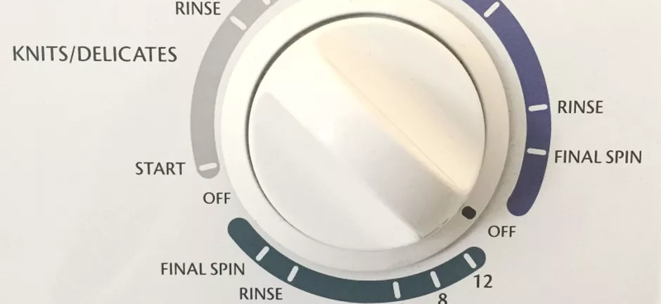
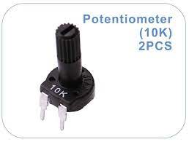

Potentiometers
Change resistance usually by rotating
Arduino can measure that change and react

Slide 7
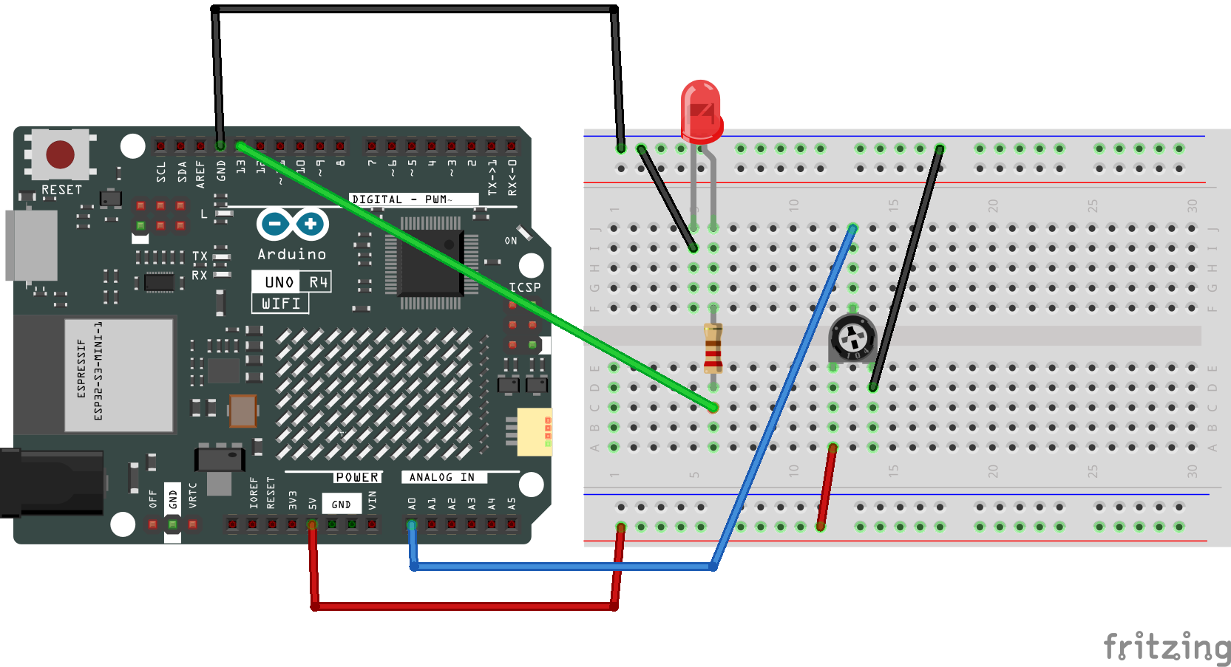
New Circuit

Slide 8

New Code!

Slide 9
int sensorPin = 0; // The potentiometer is connected to analog pin 0
int ledPin = 13; // The LED is connected to digital pin 13
int sensorValue; //This is where we will store the potentiometer's value
void setup(){
pinMode(ledPin, OUTPUT);
// Serial.begin(9600);
}
void loop(){
sensorValue = analogRead(sensorPin); // Stores potentiometer current value
//Serial.print(sensorValue);
//Serial.println(sensorValue);
digitalWrite(ledPin, HIGH); // Turn the LED on
delay(sensorValue); // Pause for sensorValue amount of time
digitalWrite(ledPin, LOW); // Turn the LED off
delay(sensorValue); // Pause for sensorValue amount of time
}

Slide 10

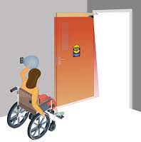
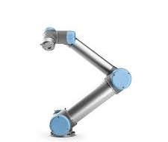
Servo Motor
Spin to a specific angle
Cannot spin continuously
Good for precision

Slide 11
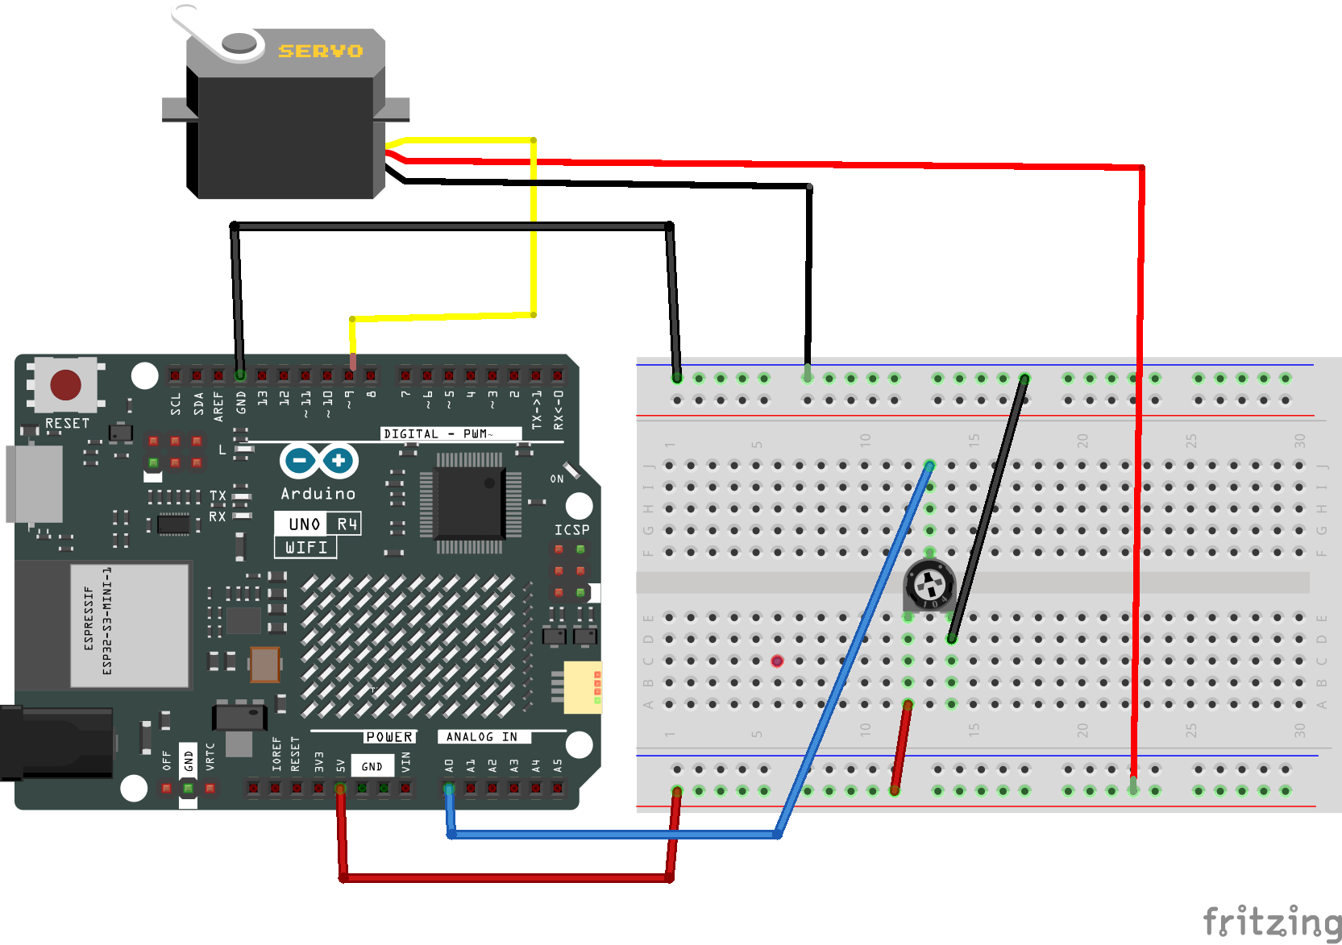

Slide 12
New Code!

Slide 13
#include <Servo.h> //Include Library
Servo servo1;
int sensorPin = 0; // The potentiometer is connected to analog pin 0
int Servomax = 180; //maximum value the servo can take
int Potmax = 1023; //maximum value the potentiometer can take
float sensorValue; //This is where we will store the pot's value. float indicates it can be a decimal.
void setup(){ // this function runs once when the sketch starts up
servo1.attach(9);
servo1.write(90);// move servos to center position -> 90°
//Serial.begin(9600);
}
void loop(){ // this function runs repeatedly after setup() finishes
sensorValue = analogRead(sensorPin) * Servomax/Potmax;
// Serial.println(sensorValue);
servo1.write(sensorValue);
delay(500);
}

Slide 14
Delta Robots

Slide 15
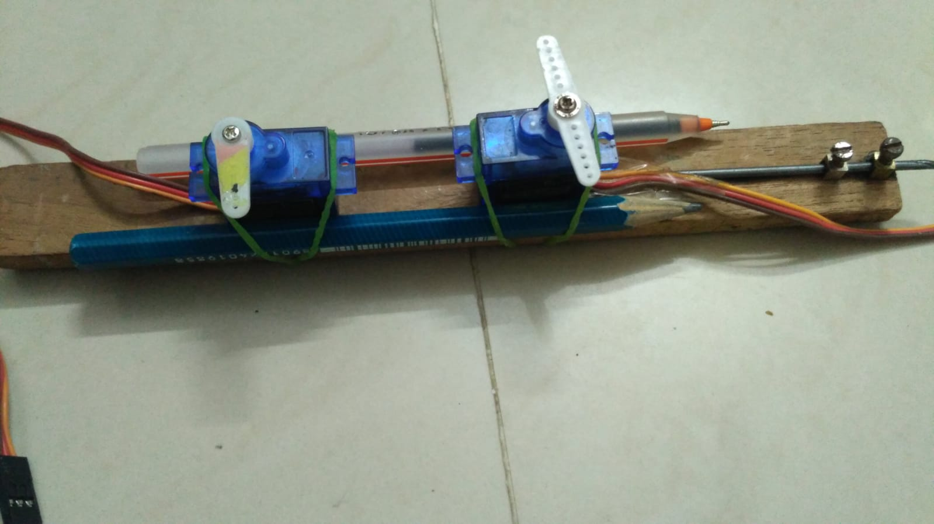
Step 1: Mount Servos

Slide 16
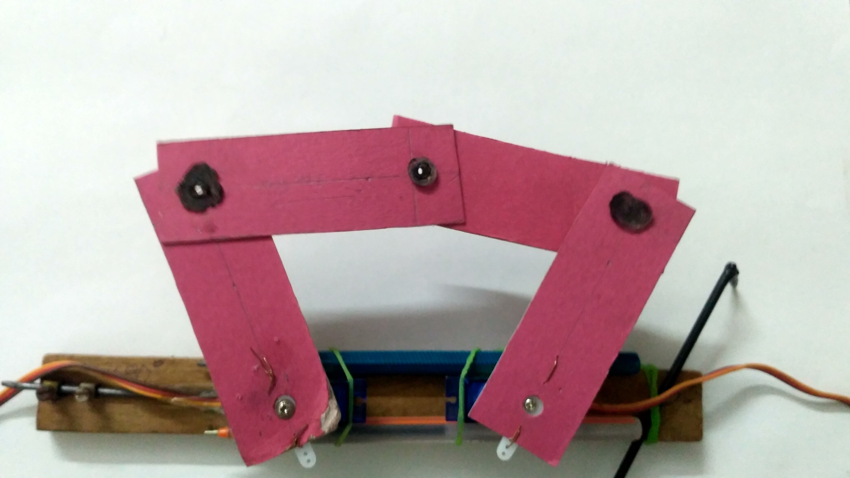
Step 2: Cut 4 links

Slide 17
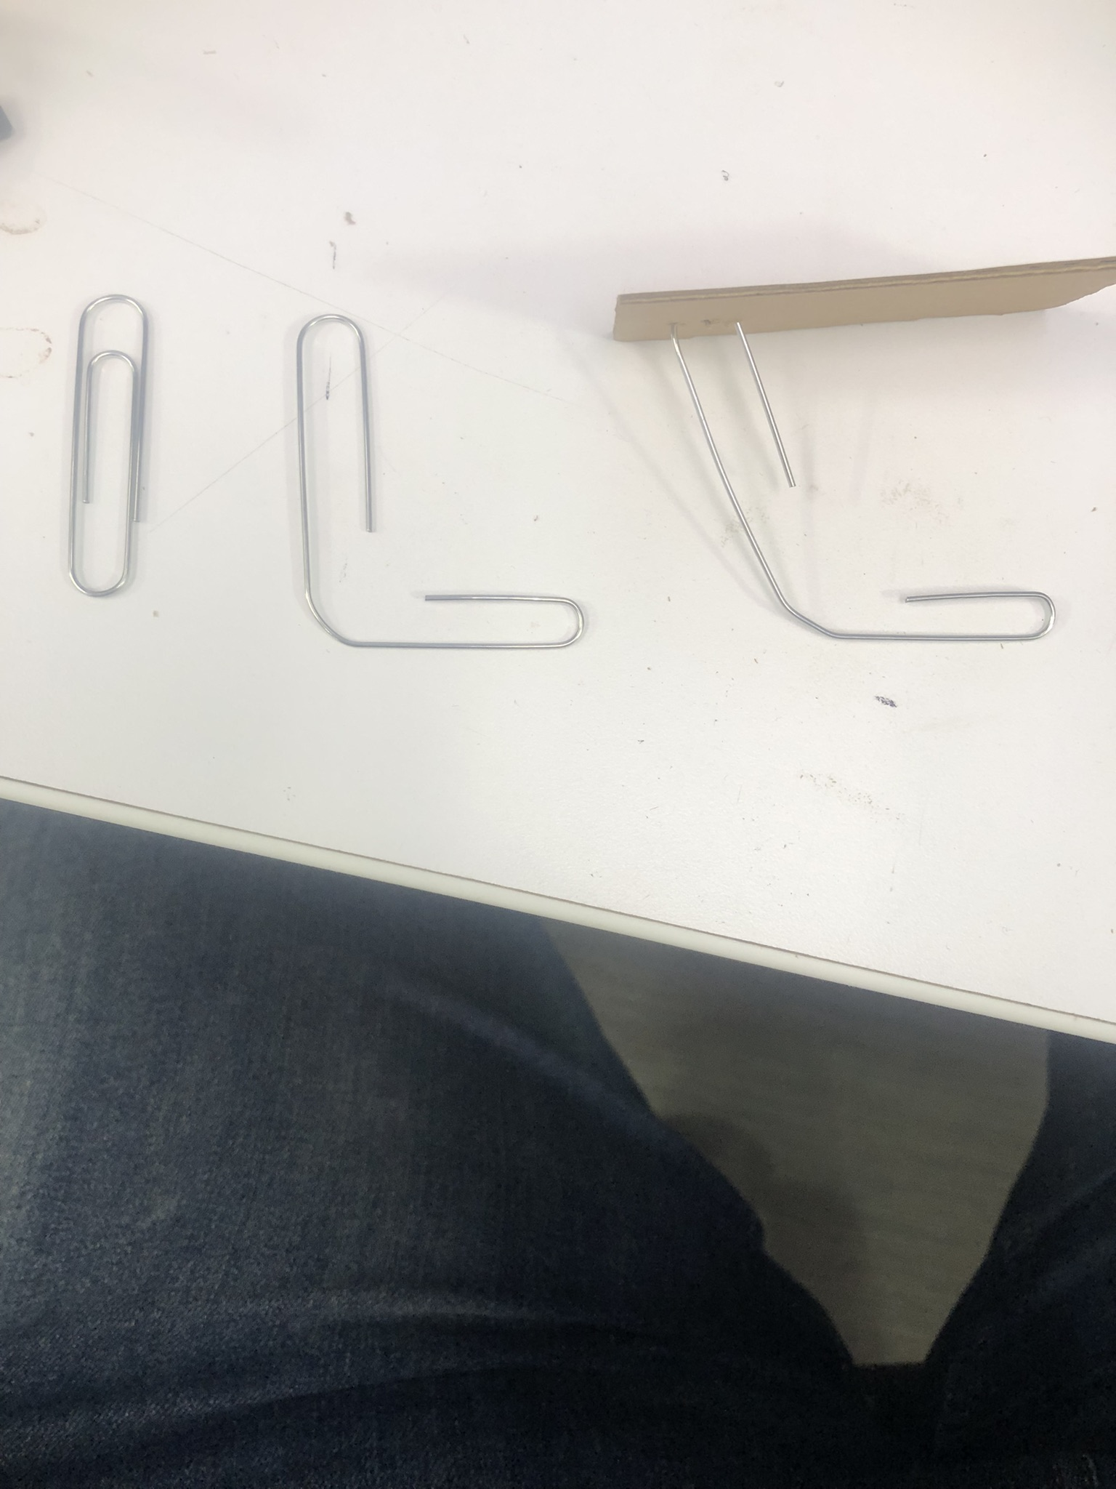
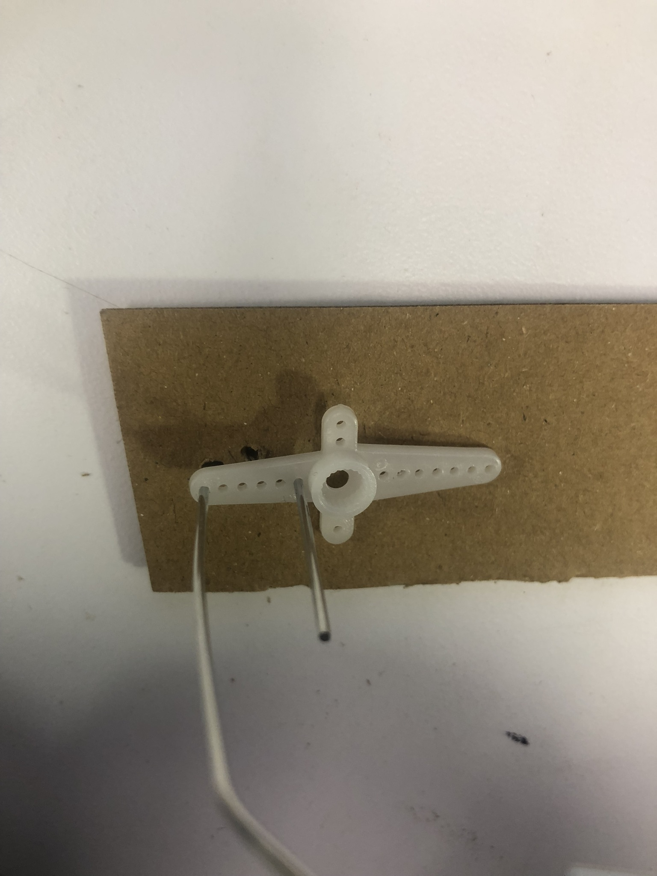
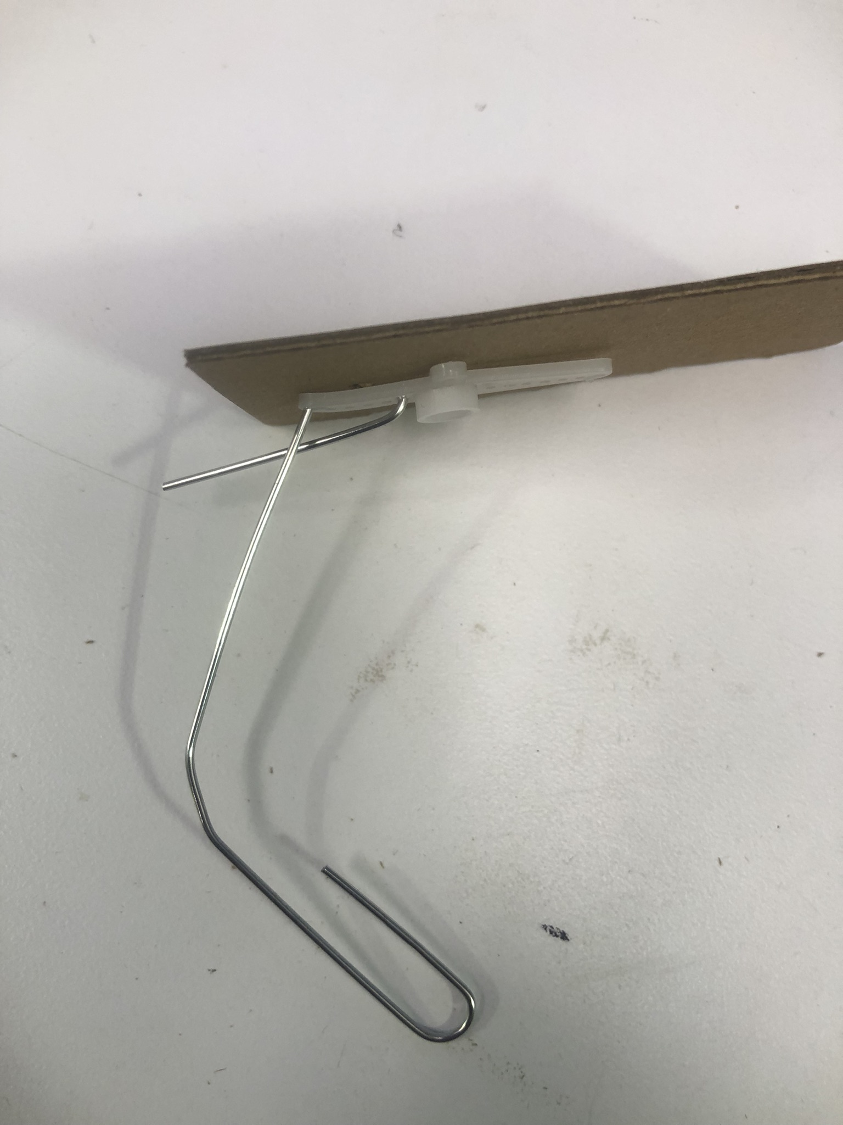
Step 3: Attach Links

Slide 18
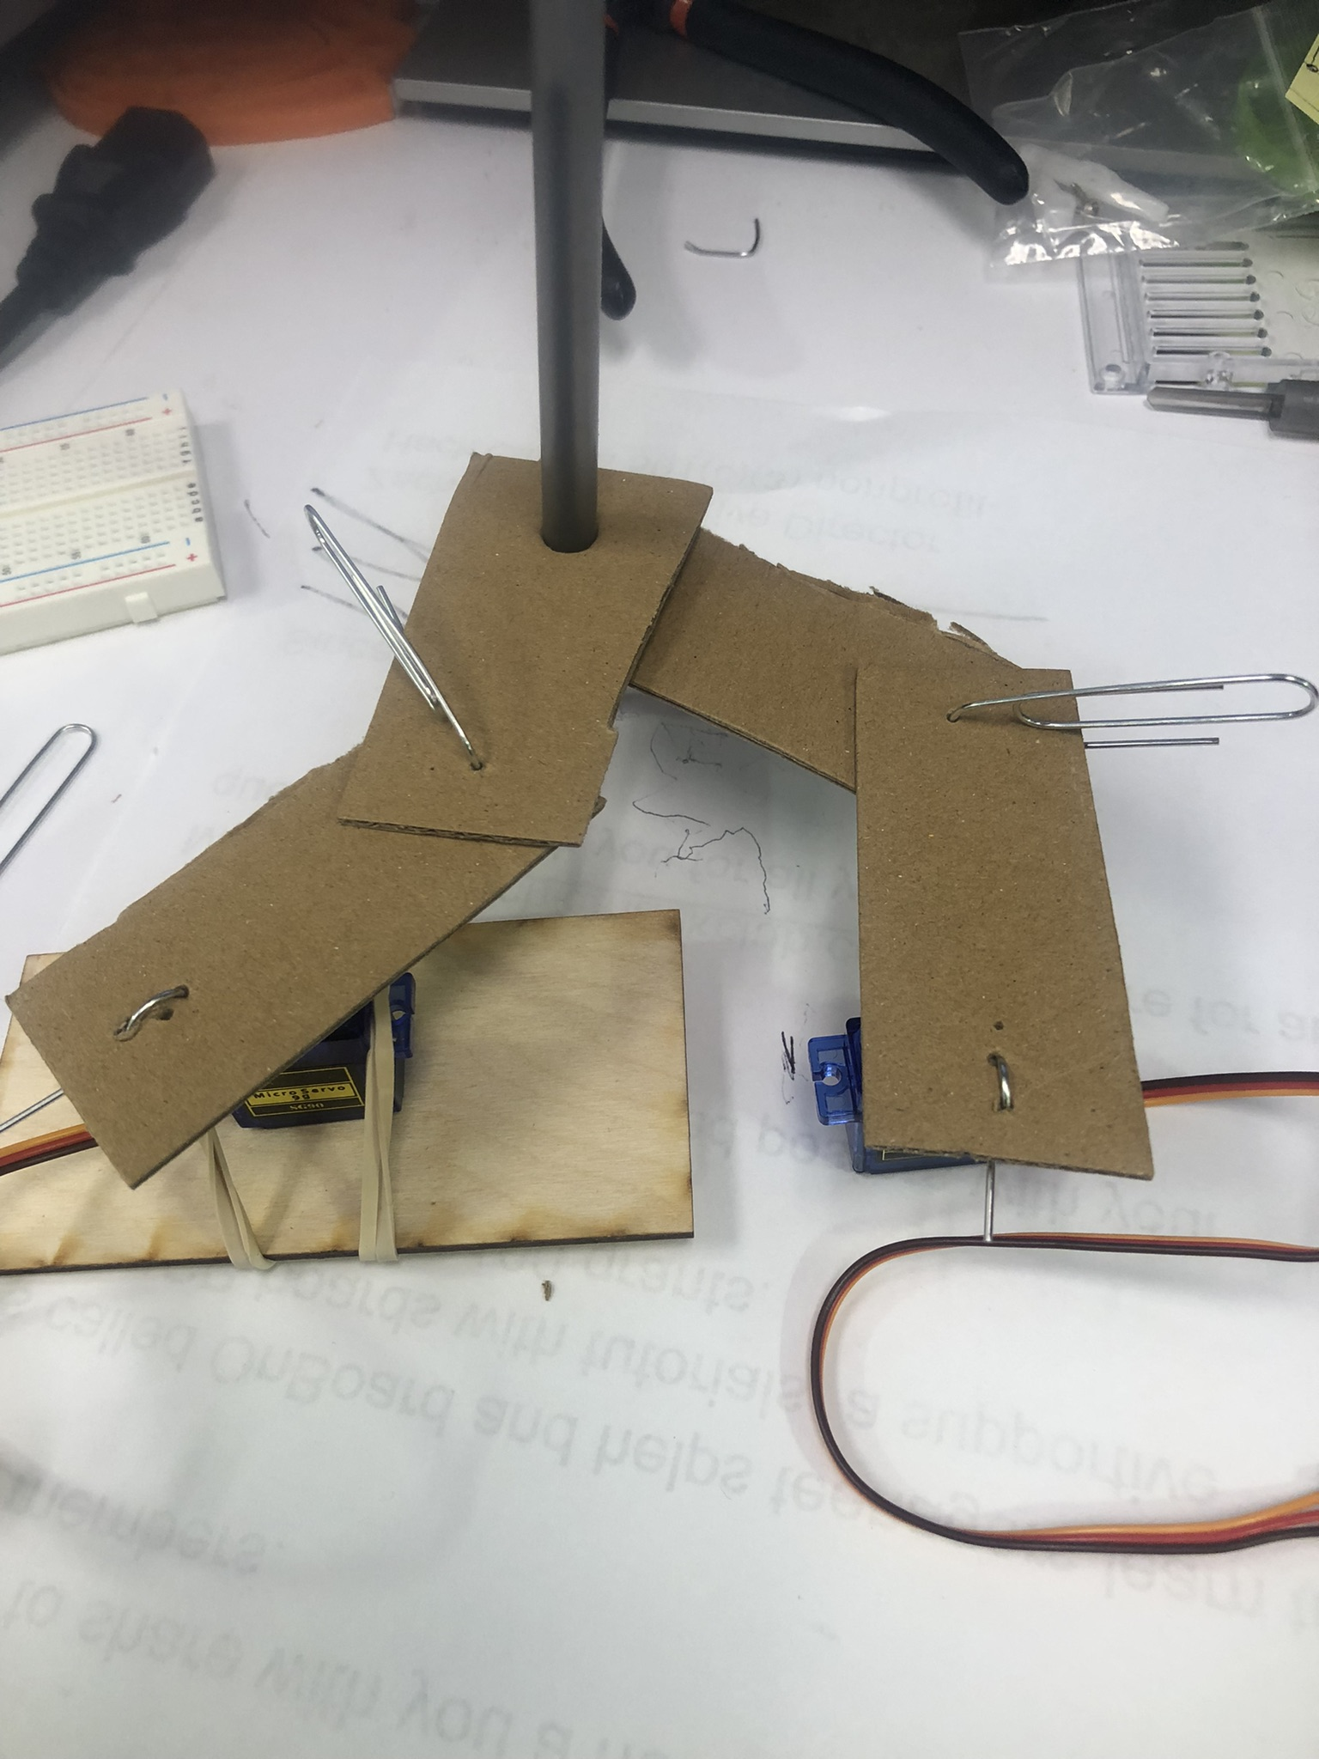
Step 4: Attach to Servos

Slide 19

Step 4: Draw!

